Slide 1
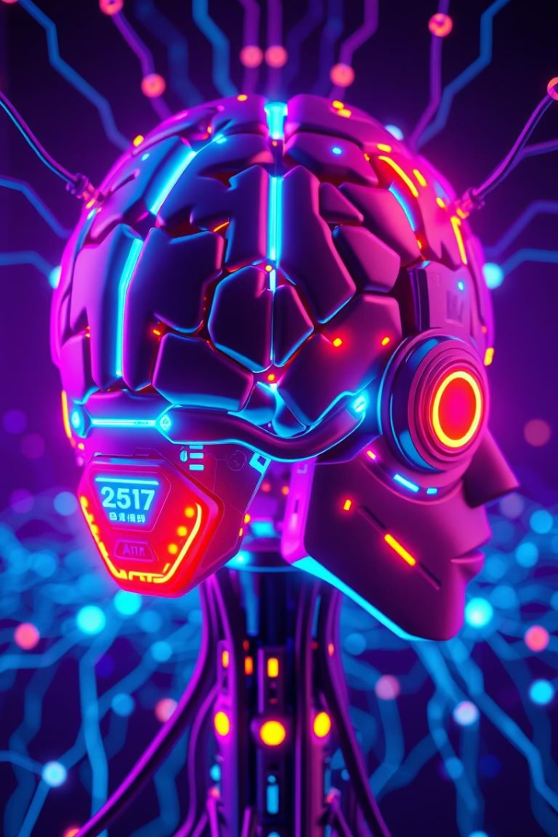
Artificial Intelligence: A Brief Overview
AI could add $15.7 trillion to the global economy by 2030. The market is growing fast at 37.3% CAGR.
It transforms industries like healthcare and transportation. Most devices we use now involve AI.

Slide 2
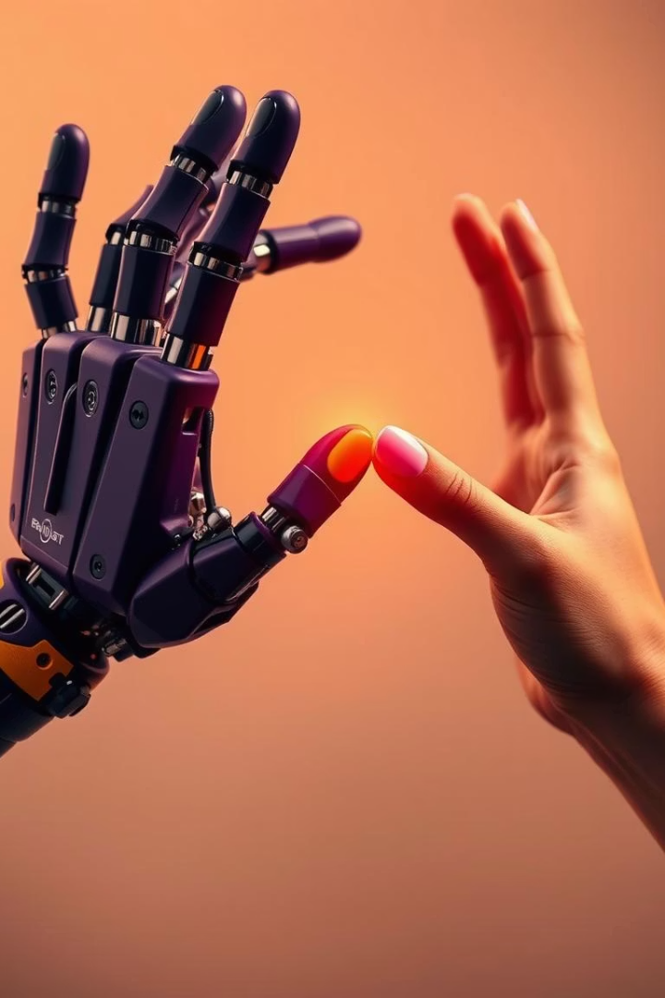

What is Artificial Intelligence?
Human-like Intelligence
Types of AI
Ranges from Narrow AI to General AI and Superintelligence.
AI systems mimic human tasks and learn over time.
Core Elements
Built on algorithms, big data, and computational power.

Slide 3

Brief History of AI
1
1956 Dartmouth Conference
Coined the term "Artificial Intelligence".
2
AI Winters
1970s & 1990s stalled progress due to tech limits.
3
Deep Blue Victory
First AI to beat chess champion Kasparov (1997).
4
Modern Breakthroughs
AlphaGo (2016) and GPT models (2018–present).

Slide 4
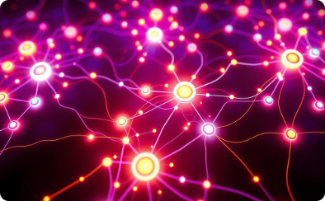
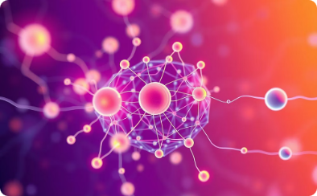


Key AI Technologies
Machine Learning
Deep Learning
Natural Language Processing
Computer Vision
Algorithms discovering patterns in large datasets.
Multi-layer neural networks solving complex problems.
Processing and interpreting visual data like images and videos.
Computers interpreting and generating human language.

Slide 5
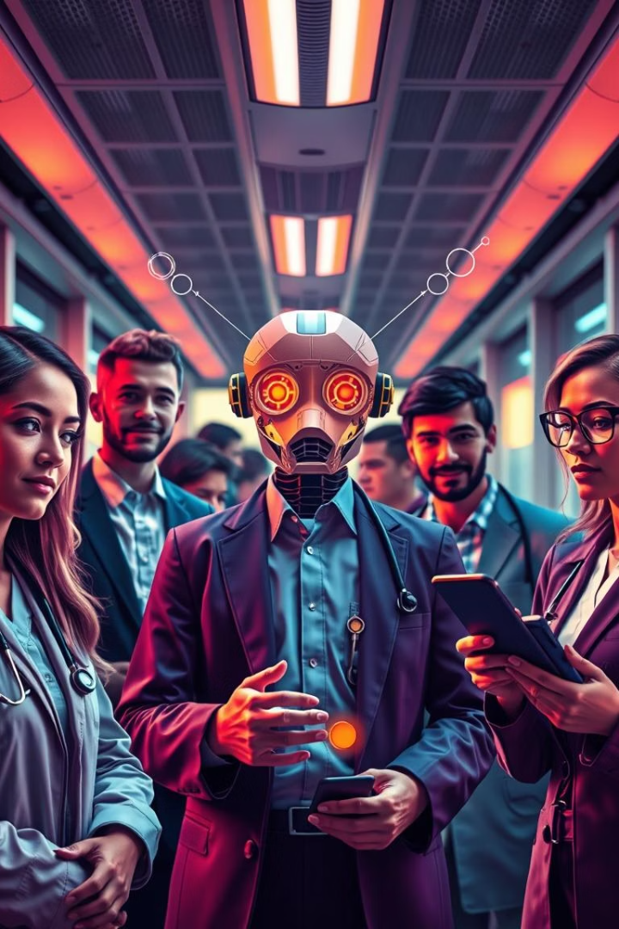
Current Applications
Healthcare
Disease diagnosis and speeding drug discovery.
Finance
Fraud detection and smart trading algorithms.
Transportation
Self-driving cars and optimized traffic flow.
Customer Service
Chatbots handle 70% of user inquiries.

Slide 6
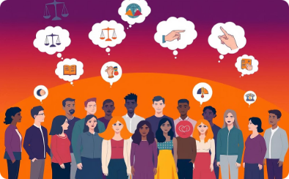

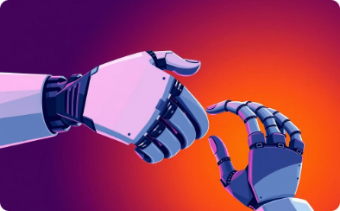
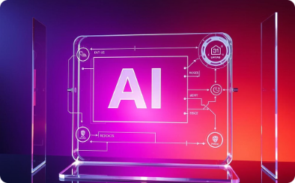
Ethical Considerations and Challenges
Bias & Fairness
Privacy
Job Impact
Transparency
AI may unintentionally reflect societal biases.
Concerns about extensive data collection and usage.
Automation can replace some jobs but also creates new roles.
The need for AI decisions to be explainable and trustworthy.

Slide 7





The Future of AI
Ubiquitous AI
Embedded in everyday gadgets and services.
Generative AI Growth
Advanced creation of content like art and text.
Human-AI Collaboration
Working together rather than replacing humans.
Multimodal Systems
Combine text, vision, and audio for richer interaction.

Slide 8




Key Takeaways
Rapid Change
Responsible Innovation
Prepare
Discussion
AI advances quickly, affecting every part of society.
Equip yourself for an AI-enhanced future.
Share questions and new ideas freely.
Balance growth with ethics and safety in mind.

